Slide 1
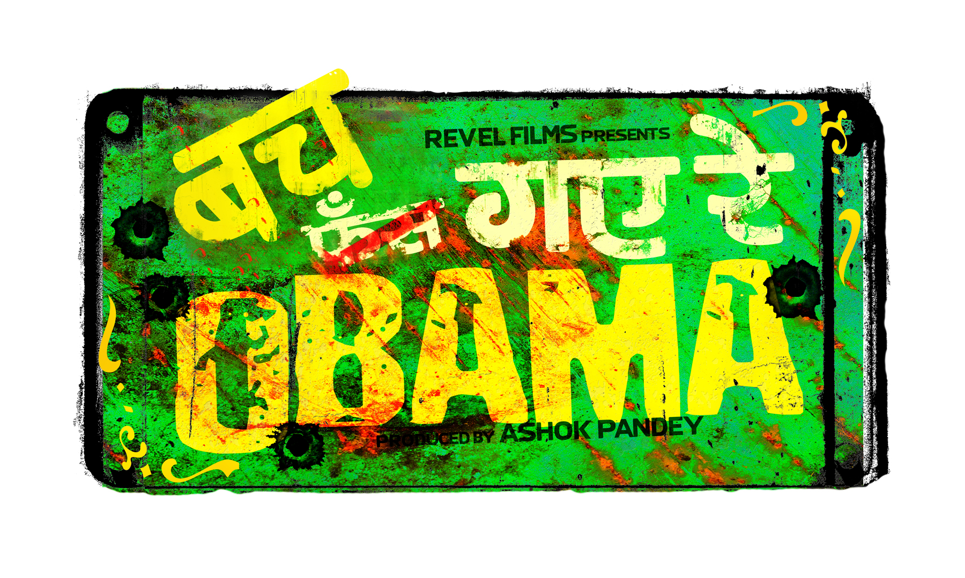
Presents Sequel to Phas Gaye Re OBAMA
By - Ashok Pandey
Producer, CEO - Revel Films
ashok.pandey@revel-films.com +919833735506

Slide 2
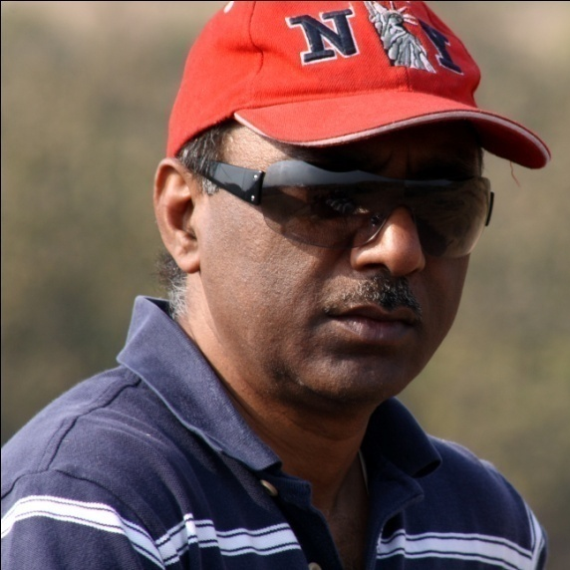
PRODUCER- ASHOK PANDEY
Chairman & CEO, Revel Films
Successful Entrepreneur having built and
run a Multinational IT business
BE (EEE) – BITS Pilani, MS (Comp Sc) – USA
Produced PHAS GAYE RE OBAMA (2010)
SAARE JAHAAN SE MEHNGA (2013)

Slide 3

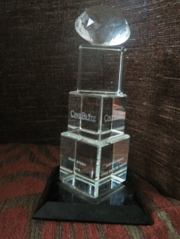

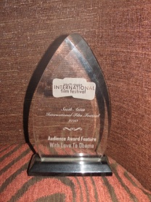


PHAS GAYE RE OBAMA
A Satire on RECESSION

Slide 4
Now Producing.. “BACH GAYE RE OBAMA”
Now Producing.. BACH GAYE RE OBAMA
A Satirical COMEDY on CORRUPTION
SEQUEL to our HIT FILM – PHAS GAYE RE OBAMA
(Registered with the Film Writers Association)

Slide 5
Now Producing.. “BACH GAYE RE OBAMA”
BACH GAYE RE OBAMA - SYNOPSIS
PRODUCER – Revel Films DIRECTOR – Options are
-Sanjay Khanduri (Ek Chalis ki Last Local, KLPD)
-Anshul Sharma (AD in PKP, CD in PKP2, Director – Saare Jahaan Se Mehnga)
STORY – Ashok Pandey SCREENPLAY – Badri Nuggehalli
CAST from PGRO NEW CAST (Potential)
Bhaisaab & His Gang members US President – Black Male Actor
Sanjay Mishra US First Lady – Black Female Actor
Manurishi Chadda & others Defence Minister – Nawazuddin
Sales Agent (Dick) – Boman Irani
Munni Madam & her Gang UP Chief Minister – Juhi Chawla/Kajol
Neha Dhupia Defence Secretary – Vrajesh Hirjee
& her gang members
DOP – Arvind Kannabiran (PGRO, NH10)
Budget – Production $2M USD Release – Early 2023

Slide 6
BACH GAYE RE OBAMA - Storyline
Bach Gaye Re Obama (BGRO) is a sequel to the hit film Phas Gaye Re Obama (PGRO). BGRO is a fast paced, fun-filled , hilarious gangster based satirical comedy in which the First Lady of the US gets kidnapped on the backdrop of massive corruption. The film canvas is larger in scale and scope than its prequel. The core of the plot starts at 10AM on the day of HOLI and ends by 2-3AM.
A major Defence deal is underway with a US Defence contractor - Tactical Dynamics, and a lot of people are going to make a lot of money through kickbacks…the story begins with the Defence deal being negotiated with India by Dick Chaudhary, an International sales agent , on behalf of Tactical Dynamics. On the Indian side, the Defence Secretary TT under direction from Yadav, Defence Minister (DM), is leading the deal with a prime objective of making money for themselves at any cost.. The US team has convinced and brought the US President to endorse the deal, to enable a definitive closure.
The First Lady of The United States (FLOTUS) takes advantage of this opportunity to visit India to further her NGO work in India. She has a dream to travel without the Secret Service around as a normal person as she is tired of her Golden Handcuffs! She fights with her husband and convinces him to enable her to travel without the ‘typical’ security arrangements and media attention so that she could see India as-is, without a made-up face. She arrives in Delhi on the day of HOLI with a minimum security detail. She is supposed to return to the US the next day. Her trip is kept under wraps to avoid any media engagements.
Bhaisaab (BS), our favorite gangster from Phas Gaye Re Obama, has now become an MLA from UP – courtesy ticket from the DM. Unfortunately, he has not been able to take advantage of his position to the extent he had imagined. He is desperate to make one last kill before he leaves office.
Lok Sabha (LS) elections are looming and the ruling Party is expected to lose. So everyone wants to make the most before the elections as they are unsure of the future!

Slide 7
Now Producing.. “BACH GAYE RE OBAMA”
BACH GAYE RE OBAMA - Storyline contd..
FLOTUS skypes with the DM and TT and tells them her desire to see Modern Rural India contrary to what they had planned for her. They get stumped and have no idea what she meant by the term Modern Rural India! TT rescues the situation and tells her that would be arranged. She insists about no media or elaborate arrangements as she wanted to see India as-is! TT suggests to DM to use BS as he is one of their own and is from a small town near Delhi. This way her trip would be in strict control. BS is roped in as FLOTUS’s escort and guide despite his apprehensions and unwillingness..
All these characters (Dick, DM, TT, BS, CM) are highly selfish, untrustworthy, unscrupulous, ready to stab each other in the back but appear to be best friends on surface! Just mean people who will do anything for Money and Power!!
All was going well until BS decides to kidnap FLOTUS. Instead of asking for ransom from the President of the US, BS puts the gun of ransom on the DM staking a claim on a portion of the kickbacks from this Defence deal.
Now, the story ramps up on a cat and mouse game between Yadav and BS. The UP CM Bharti Devi is livid when she learns that FLOTUS is with BS and jumps into the fray. She gets the UP Police to track and capture BS. The DM presses MARCOs (Marine Core Commandos) into service to track and capture BS. Alongside this wild chase, Chaudhary and TT continue to spice up the ‘kickback’ brew.. During this chaos, the US tracking team gets a whiff of imminent danger to FLOTUS. They get the President involved, who does not want it to become an International incident and wants to keep this a secret to avoid embarrassment. The US sends a rescue mission for FLOTUS, commanded by the President himself.
BS is on the run with FLOTUS, who has no clue of the chaos. She is just enjoying the trip visiting rural India. The DM desperately tries to salvage the deal, without giving-in to the ransom demands from BS, who is on a trip of his own - entertaining his hostage while arm-twisting the DM into coughing up the ransom.. In this cat and mouse game, which is laced with lies, betrayal, unscrupulous and nefarious activities, who wins, what happens to FLOTUS,..does DM give-in or is BS trapped…does CM get a piece of the action... is Dick able to make the deal while attempting to satisfy the greedy politicians…how far and deep would Yadav , CM and TT go to quench their greed.. forms the crux of the film.

